Slide 1
Lab 5 - Banker’s Algorithm
Made by: Amin Avan

Slide 2
Overview: (1)
Writing a multithreaded program (C) that implements Banker’s algorithm.
Several customers’ request & release resources from the bank.
Banker will consider requests from n customers for m resources types.
Banker will grant a request only if it leaves the system in a safe state.

Slide 3
Overview: (2)
When a new process enters the system
process must declare the maximum number of instances of each resource type that it may need.
This number may not exceed the total number of resources in the system.
When a user requests a set of resources, the system must determine whether the allocation of these resources will leave the system in a safe state.
If it will, the resources are allocated; otherwise, the process must wait until some other process releases enough resources.

Slide 4
Banker’s algorithm: (1)
A resource allocation & deadlock avoidance algorithm used in OS to ensure that a computer system is not entering an unsafe state.
Data structures for a system with ‘n’ number of processes, and ‘m’ number of resource types
available:
A vector of length ‘m’ indicates the number of available resources of each type.
/* the available amount of each resource */
int available[NUMBER OF RESOURCES];
int available[NUMBER OF RESOURCES] = {10, 5, 7};
# available[0] = 10, available[1] = 5, available[2] = 7 #

Slide 5
Banker’s algorithm: (2)
A resource allocation & deadlock avoidance algorithm used in OS to ensure that a computer system is not entering an unsafe state.
Required data structures of systems with ‘n’ number of processes, and ‘m’ number of resource types
Max:
An n×m matrix defines the maximum demand of each process.
/*the maximum demand of each customer */
int maximum[NUMBER OF CUSTOMERS][NUMBER OF RESOURCES];
int maximum[NUMBER_OF_CUSTOMERS][NUMBER_OF_RESOURCES] = {
{7, 5, 3}, {3, 2, 2}, {9, 0, 2}, {2, 2, 2}, {4, 3, 3} };
# Customer 0 could demand up to 7 instances of Resource 0,
5 instances of Resource 1, and
3 instances of Resource 2.

Slide 6
Banker’s algorithm: (3)
A resource allocation & deadlock avoidance algorithm used in OS to ensure that a computer system is not entering an unsafe state.
Required data structures of systems with ‘n’ number of processes, and ‘m’ number of resource types
Allocation:
An n×m matrix defines the number of resources of each type currently allocated to each process.
/* the amount currently allocated to each customer */
int allocation[NUMBER OF CUSTOMERS][NUMBER OF RESOURCES];
int allocation[NUMBER_OF_CUSTOMERS][NUMBER_OF_RESOURCES] = {
{0, 1, 0}, {2, 0, 0}, {3, 0, 2}, {2, 1, 1}, {0, 0, 2} };
#Customer 0 currently has 0 instances of Resource 0,
1 instance of Resource 1, and
0 instances of Resource 2.#

Slide 7
Banker’s algorithm: (4)
A resource allocation & deadlock avoidance algorithm used in OS to ensure that a computer system is not entering an unsafe state.
Required data structures of systems with ‘n’ number of processes, and ‘m’ number of resource types
Need:
An n×m matrix indicates the remaining resource need of each process.
you should compute ‘need’ dynamically by a loop calculating the ‘need’ by subtracting the current allocation from the maximum for each customer and resource type.
/* the remaining need of each customer */
int need[NUMBER OF CUSTOMERS][NUMBER OF RESOURCES];
int need[NUMBER_OF_CUSTOMERS][NUMBER_OF_RESOURCES];
for (int i = 0; i < NUMBER_OF_CUSTOMERS; i++) {
for (int j = 0; j < NUMBER_OF_RESOURCES; j++) {
need[i][j] = maximum[i][j] - allocation[i][j];
}
}

Slide 8
Banker’s algorithm: (5)
The Banker's algorithm functions based on two underlying algorithms:
Safety Algorithm
check if the current state of the system is safe?
Resource-Request Algorithm
check if the requests can be safely granted?

Slide 9
Banker’s algorithm - safety Algorithm:
Work = available[NUMBER OF RESOURCES]; Finish[i] = false for i = 0, 1, …, n-1; # n is the number of process
for each i in Finish[i]:
if [(Finish[i]==false) && (Need_{i}≤work)]:
Work = Work + Allocation_{i} Finish[i] = true Go to step 2;
if Finish[i] == true for all i:
‘safe state’
else:
‘unsafe state’

Slide 10
Banker’s algorithm - Resource-request algorithm:
if (Request_{i} ≤ Need_{i}):
if (Request_{i} ≤ Available_{i}):
Available = Available – Request_{i}; Allocation_{i} = Allocation_{i} + Request_{i}; Need_{i} = Need_{i} – Request_{i};
else:
process_{i} must wait as the resources are not available.
else:
error as the process has exceeded its maximum claim.

Slide 11
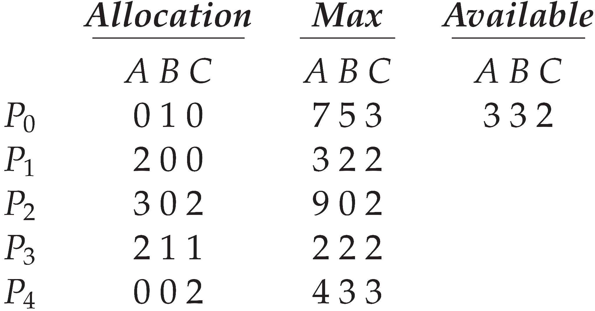
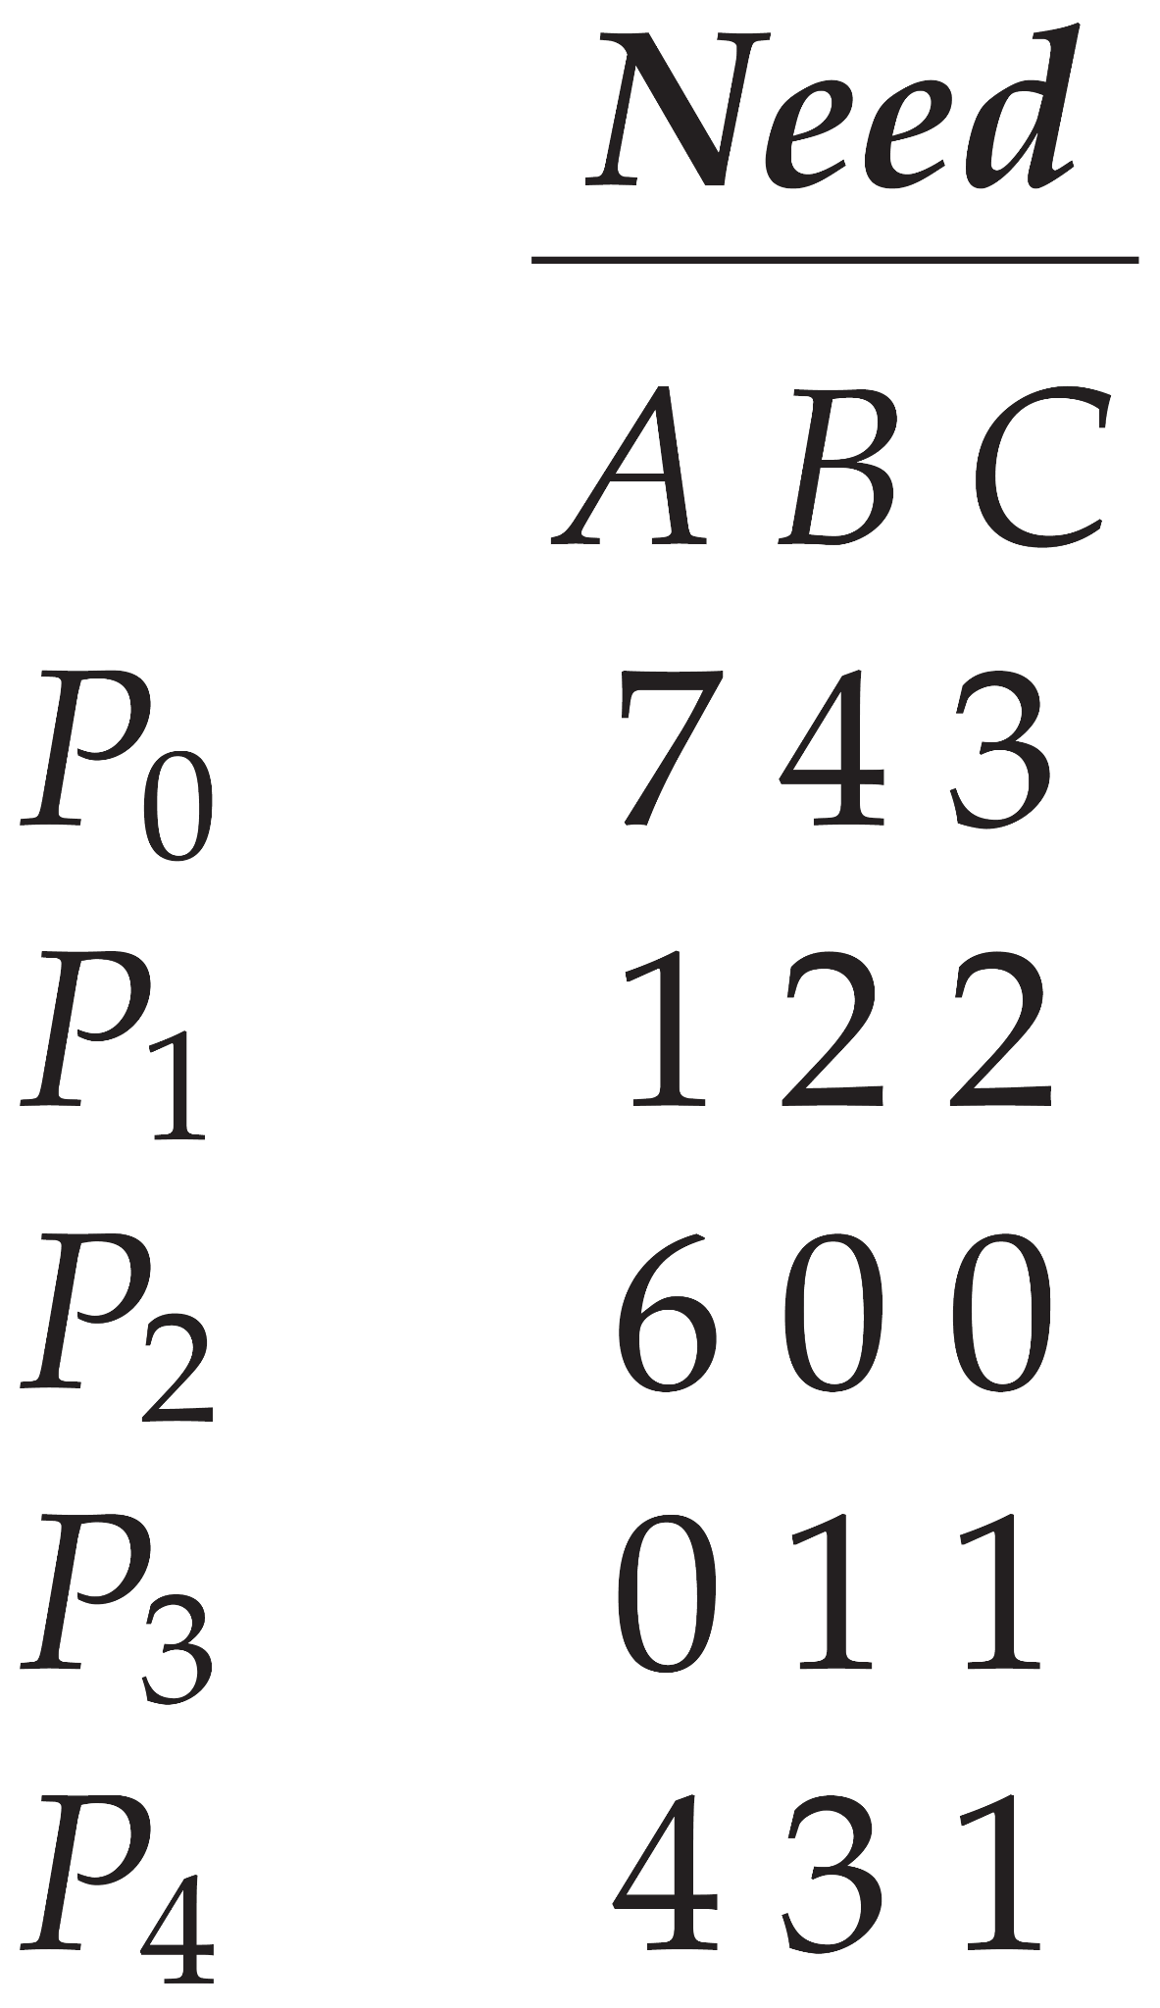
Example: (1)
A system with:
five processes
three resource types
A = 10
B = 5
C = 7
at (t = 0):

Slide 12
Example: (2)
Execute ‘Safety Algorithm’ to check if the system is in a ‘safe state’?
the system is in a ‘safe state’
Work = available[NUMBER OF RESOURCES]; Finish[i] = false for i = 0, 1, …, n-1;
for each i in Finish[i]:
if [(Finish[i]==false) && (Need_{i}≤work)]:
Work = Work + Allocation_{i} Finish[i] = true Go to step 2;
if Finish[i] == true for all i:
‘safe state’
else:
‘unsafe state’

Slide 13
Example: (4)
if P1 request one additional instance of resource type A and two instances of resource type C.
Request1 = (1,0,2)
Execute ‘Resource-Request Algorithm’ to check if the requests can be safely granted?
if (Request₁(1,0,2) ≤ Need₁(1,2,2)):
if (Request₁==(1,0,2) ≤ Available₁==(3,3,2)):
Available (2,3,0) = Available (3,3,2) – Request₁ (1,0,2); Allocation₁ (3,0,2) = Allocation₁ (2,0,0) + Request₁(1,0,2); Need₁ (0,2,0) = Need₁ (1,2,2) – Request₁ (1,0,2);
else:
process₁ must wait as the resources are not available.
else:
error as the process has exceeded its maximum claim.

Slide 14
Customers - Multithreading in C:
Involves using the “pthreads” library to create, execute, and manage multiple threads within a single process.
Include the header file ‘pthread.h’ in your code.
Key functions:
creating threads: ‘pthread_create’
waiting for threads to finish: ‘pthread_join’
exiting a thread: ‘pthread_exit’

Slide 15
Customers: (1)
Include the ‘pthread’ library and define the number of customers:
#include <pthread.h> #include <stdlib.h> #include <stdio.h> #define NUMBER_OF_CUSTOMERS 5

Slide 16
Customers: (2)
Create thread functions for requesting resources and releasing resources:
int requestResource(int customer num, int request[]) { // Logic to request the resources return 0; // Return ‘0’ if the request has been granted return -1; // Return ‘-1’ if the request has not been granted } int releaseResources(int customer num, int release[]) { // Logic to release the resources return 0; // Return ‘0’ if the request has been granted return -1; // Return ‘-1’ if the request has not been granted }

Slide 17
Implementation of program:
./a.out 10 5 7
You need to invoke your program by passing the number of instances for each type of resources.
e.g.,:
ten instances of the first type
five instances of the second type
seven instances of the third type

Slide 18
Thank you!

